Slide 1
Overview of Causal Inference
Danielle Stevens IRTA postdoctoral fellow National Institute of Environmental Health Sciences

Slide 2
Outline & References
What is causal inference (Smith et al)
Research questions
Causal framework
G-methods (Naimi et al)
Propensity scores (IPTW)
R tutorial
G-computation
R tutorial

Slide 3
Outline & References
Jennifer Ahern & Laura Balzer
SER Causal Inference
SER Long’l Causal Inference
Maya Petersen & Laura Balzer
Introduction to Causal Inference
https://www.ucbbiostat.com/
Ehsan Karim & Hanna Frank
https://ehsanx.github.io/TMLEworkshop/
Thomas Love
https://github.com/thomaselove/ichps2018
Notes:
These were a huge help for me as I got started on my causal inference journey, and I adapted some of the materials from these various presentations and courses for this talk.
I’ll provide some additional links to other good papers and tutorials for those interested in searching out more material on causal inference

Slide 4

Research questions
Current paradigm
What is the expected difference in an outcome for a one-unit increase in exposure in our study population?
Current paradigm
What is the expected difference in birthweight for a one-unit increase in airborne metal exposure in Milwaukee, 2011-2013?
80
Hg
Mercury
200.59
Keil et al. 2021, Am J Epidemiol
Notes:
Current paradigm, which is statistical inference, examines…

Slide 5

Research questions
Causal inference
If we intervened to reduce one or more exposures in a specific way in our study population, how would outcome distributions change?
Causal inference
What is the difference in mean birthweight observed if we closed 3 coal-fired plants releasing airborne metals in Milwaukee, 2011-2013?
80
Hg
Mercury
200.59
Keil et al. 2021, Am J Epidemiol

Slide 6
Research questions
Current paradigm
What is the expected difference in birthweight for a one-unit increase in airborne metal exposure in Milwaukee, 2011-2013?
Causal inference
What is the difference in the birthweight distribution observed if we closed 3 coal-fired plants releasing airborne metals in Milwaukee, 2011-2013?
When research questions have to do with how things work or how best to intervene to improve health, they are often causal questions.
Keil et al. 2021, Am J Epidemiol

Slide 7
Pros of causal inference
Not every research question is causal, but thinking causally about the research we do can have benefits:
Think critically about research, e.g.,
What is a reasonable and meaningful unit change in exposure to examine?
Real-world implications of research
Thinking in terms of interventions/RCT instead of associations
Policy implications
Feasibility of examining research question
Infeasible to have RCT for some exposures
Control for time-varying confounding

Slide 8
Cons of causal inference
… And downsides:
Overconfidence in assumptions
Thinking that your findings apply more broadly than they do
Misinterpreting results
Thinking that your observational analysis perfectly replicates RCT
Sometimes more difficult to formulate and answer a causal question
Complexity >> common sense
Follow a formal causal framework
Notes:
Complexity obscuring common sense, and you should step back and return to the basics
To help us address this, there are formal causal frameworks we can follow.

Slide 9

Current paradigm: statistical inference
Sample individuals from underlying population and for each subject observe:
X = Prenatal vitamin use (1=use, 0=no use)
Y = Preterm delivery (1=preterm, 0=not preterm)
Estimate association between taking prenatal vitamin vs not on risk of preterm delivery in study population as:
P(Y=1 | X=1) – P(Y=1 | X=0)

Slide 10


Statistical vs causal inference
Statistical inference tells us the probability of occurrence in our data
Exposure doesn’t occur in all participants, only self-selected group
e.g., take vitamins because you know you are pregnant, encouraged by medical provider, educated about benefits
Statistical inference cannot extend into the hypothetical

Slide 11
Causal inference
Causal inference tells us how a data distribution would change if we intervened to change exposure
How would preterm delivery risk change if all pregnant persons in our study had taken vitamins?
How would preterm delivery risk change if we assigned pregnant persons who had had a prior preterm delivery in our study to take vitamins?
Causal inference goal: draw inference about parameters for a distribution we do not (fully) observe in our data
Notes:
Causal parameters provide a summary of how a data distribution would change if the experimental conditions changed.
Causal inference goal: inference about parameters of a distribution we do not (fully) observe in our data

Slide 12
Causal inference framework
State the research question & hypothetical experiment
Define causal model & parameter of interest
Link causal model to observed data & define statistical model
Link causal effect to parameter estimable in observed data
Choose & apply estimator
Make inferences

Slide 13
Causal inference framework
State the research question & hypothetical intervention
Define causal model & parameter of interest
Link causal model to observed data & define statistical model
Link causal effect to parameter estimable in observed data
Choose & apply estimator
Make inferences

Slide 14
State the research question & hypothetical intervention
Be explicit about:
Study (target) population
Exposure
Outcome
How to feasibly change the exposure
What is the hypothetical intervention?
What is the RCT?

Slide 15




Envisioning hypothetical interventions in observational studies
↓ Vehicle emissions
Vehicle emissions
While we can examine just vehicle emissions & asthma incidence, helpful to consider implications of different interventions that can be feasibly taken
Notes:
How can we pose research questions about interventions in observational data?
Example for environmental exposures is replacing gas-powered motor vehicles with bicycles (dual impact of PA and reduction in emissions) versus electric vehicles (reduction in emissions only), and the impact that might have on asthma incidence.

Slide 16
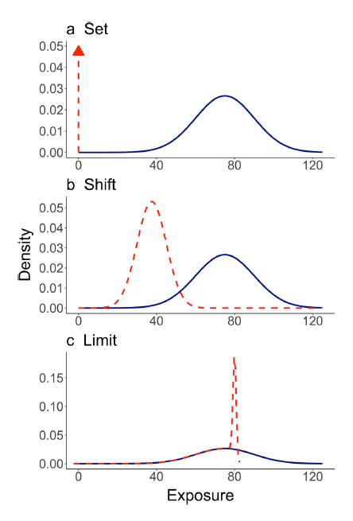
Link study comparisons to public health actions that can be feasibly taken by decision-makers
Operationalize intervention as a modification to measured exposure
Set exposure to specific value
Shift exposure distribution
Limit exposure to threshold value
Smith et al. 2022, Curr Environ Health Rep
Notes:
If no intervention has taken place, must operationalize the intervention as a modification to the exposure distribution
Set exposure to specific value
Shift exposure distribution
Limit exposure to < threshold value
These new levels are compared to those expected to occur under no intervention, referred to as “natural course”

Slide 17
Link study comparisons to public health actions that can be feasibly taken by decision-makers
Operationalize intervention as a modification to measured exposure
Set exposure to specific value
e.g., set everyone in dataset unexposed vs exposed
Smith et al. 2022, Curr Environ Health Rep
Notes:
Blue in natural course
Compare outcomes under natural course to outcomes under scenario where we set everyone in dataset to unexposed

Slide 18
Link study comparisons to public health actions that can be feasibly taken by decision-makers
Operationalize intervention as a modification to measured exposure
Shift exposure distribution
e.g., everyone in dataset has 50% less exposure
Smith et al. 2022, Curr Environ Health Rep
Notes:
If no intervention has taken place, must operationalize the intervention as a modification to the exposure distribution
Set exposure to specific value
Shift exposure distribution
Limit exposure to < threshold value
These new levels are compared to those expected to occur under no intervention, referred to as “natural course”

Slide 19
Link study comparisons to public health actions that can be feasibly taken by decision-makers
Operationalize intervention as a modification to measured exposure
Limit exposure to threshold value
e.g., apply regulatory thresholds to exposure
Smith et al. 2022, Curr Environ Health Rep
Notes:
If no intervention has taken place, must operationalize the intervention as a modification to the exposure distribution
Set exposure to specific value
Shift exposure distribution
Limit exposure to < threshold value
These new levels are compared to those expected to occur under no intervention, referred to as “natural course”

Slide 20
Garcia et al. & Urman et al.
PM2.5 and NO2 effects on childhood asthma incidence and lung development in CA, 1993-2014
Set PM2.5 or NO2 to baseline values observed in 1993
Shift PM2.5 or NO2 distributions downward by 10, 20, or 30%
Limit PM2.5 or NO2 values at hypothetical regulatory limits of 15, 12, 10 ug/m3 and 30, 20, 10 ppb, respectively
Comparison was “natural course” or air pollution concentrations as observed over follow-up
Smith et al. 2022, Curr Environ Health Rep
Notes:
All interventions were compared to the natural course in which air pollution concentrations were assigned as observed over follow-up.

Slide 21
State the research question & hypothetical intervention
Interested in the impact of tap water lead on neurodevelopmental outcomes in school-aged children
Statistical inference research question:
Causal inference research question:
What is the association between a one-unit increase in tap water lead and risk of adverse neurodevelopmental outcomes in school-aged children?
How would the risk of adverse neurodevelopmental outcomes in school-aged children change if we intervened to set tap water lead levels to below EPA standards (15 ppb)?
Notes:
Ask for examples of research questions
Statistical inference:
What is the association between a one-unit increase in tap water lead and neurodevelopmental outcomes in school-aged children?
Causal inference:
How would the risk of adverse neurodevelopmental outcomes in school-aged children change if we intervened to set tap water lead levels to below EPA standards (15 ppb)?
How would the risk of adverse neurodevelopmental outcomes in school-aged children change if we had provided participants with a water filter that removes 99% of lead from tap water?

Slide 22
State the research question & hypothetical intervention
Interested in the impact of tap water lead on neurodevelopmental outcomes in school-aged children
Statistical inference research question:
Causal inference research question:
What is the association between a one-unit increase in tap water lead and risk of adverse neurodevelopmental outcomes in school-aged children?
How would the risk of adverse neurodevelopmental outcomes in school-aged children change if we had provided participants with a water filter that removes 90% of lead & other pollutants from tap water?
Notes:
Ask for examples of research questions
Statistical inference:
What is the association between a one-unit increase in tap water lead and neurodevelopmental outcomes in school-aged children?
Causal inference:
How would the risk of adverse neurodevelopmental outcomes in school-aged children change if we intervened to set tap water lead levels to below EPA standards (15 ppb)?
How would the risk of adverse neurodevelopmental outcomes in school-aged children change if we had provided participants with a water filter that removes 99% of lead from tap water?

Slide 23
State the research question & hypothetical intervention
Interested in impact of noise from a local airport on sleep quality in older adults
Causal inference research questions:

Slide 24
Causal inference framework
State the research question & hypothetical intervention
Define causal model & parameter of interest
Link causal model to observed data & define statistical model
Link causal effect to parameter estimable in observed data
Choose & apply estimator
Make inferences

Slide 25
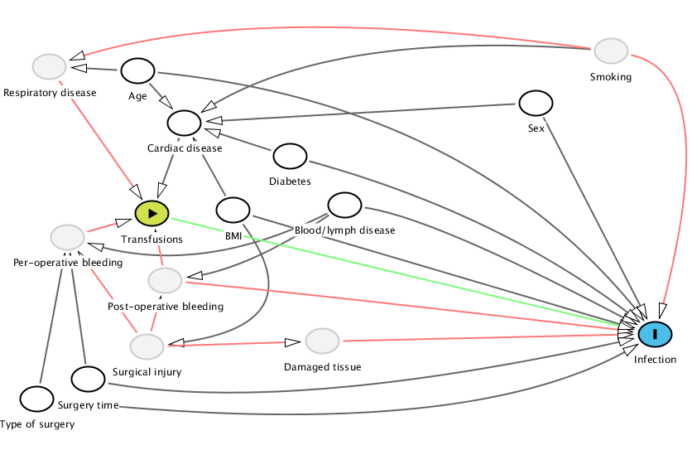
Define causal model & parameter of interest
In other words, draw a DAG!
Informed by prior knowledge
Often these are more complicated than we want them to be
Use counterfactuals to define the causal parameter
Source: https://gforge.se/2014/05/dag/

Slide 26
Define causal model & parameter of interest
Simple static intervention, using counterfactuals
Confounders
Counterfactual COVID incidence with masking
Masking
Confounders
No masking
Counterfactual COVID incidence without masking

Slide 27
Define causal model & parameter of interest
Simple static intervention, using counterfactuals
Confounders
Y₁
Average treatment effect:
E[Y₁] – E[Y₀]
Causal risk difference:
P(Y₁=1) – P(Y₀=1)
X=1
Confounders
X=0
Y₀
Many other causal parameters are possible!

Slide 28
Causal inference framework
State the research question & hypothetical intervention
Define causal model & parameter of interest
Link causal model to observed data & define statistical model
Link causal effect to parameter estimable in observed data
Choose & apply estimator
Make inferences

Slide 29
Link causal model to observed data & define statistical model
Causal model = DAG
Describes the set of processes that give rise to your observed data
Causal model implies the statistical model
Statistical model is set of possible distributions of observed data
Often no assumptions on distribution of unmeasured factors or functional form of equations
If we do know the form of the function between X, confounders, and Y then we should specify that
Statistical model often non-parametric
Notes:
If we know that covariates interact, can accommodate that in the model

Slide 30
Causal inference framework
State the research question & hypothetical intervention
Define causal model & parameter of interest
Link causal model to observed data & define statistical model
Link causal effect to parameter estimable in observed data
Choose & apply estimator
Make inferences

Slide 31



Assess identifiability
Identifiability: link causal effect to parameter estimable in observed data
Are data sufficient to answer the causal question under model assumptions?
What are some assumptions?
Counterfactual consistency
Potential outcome under observed exposure is indeed observed outcome
Conditional exchangeability
Adequate control for confounding and selection bias
Positivity
Sufficient variability in exposure within confounder strata
Empirically assess by examining exposure distributions within strata of confounders
Notes:
Correct causal model: Temporality, consistency, stability
No measurement error

Slide 32
Assess identifiability
Likely that data and model are not sufficient
What then?
Get more (better) data
Do the best job with what you have, understand limitations, & make convenience assumptions
Convenience assumptions, e.g.,
“No unmeasured confounding” when we suspect there may be some confounding that we did not measure

Slide 33
Causal inference framework
State the research question & hypothetical intervention
Define causal model & parameter of interest
Link causal model to observed data & define statistical model
Link causal effect to parameter estimable in observed data
Choose & apply estimator
Make inferences

Slide 34



Choose & apply estimator
This is when we get into the statistics!
Several options available:
Substitution estimators (e.g., g-computation)
Propensity score based (e.g., IPTW)
Doubly robust (e.g., TMLE)

Slide 35
Estimators
Parametric
Assume that we know the relationship between your exposure, covariates, & outcome
Specify this relationship with parameters e.g., regression with main terms & some interactions or squared terms
Non-parametric
We know nothing about form of relationship between exposure, covariates, & outcome
Divide data into all possible combinations of exposure-covariate relationships and average stratum-specific exposure-outcome relations
This would be a lot of work!

Slide 36

Estimators
Semi-parametric
Smooth over data with weak support during estimation using data-adaptive estimation or machine learning
Statistical parameter
Y = outcome
A = exposure
W = covariates
Equals the ATE if identifiability assumptions hold

Slide 37
Causal model & parameter of interest
Simple static intervention, using counterfactuals
Confounders
Y₁
Average treatment effect:
E[Y₁] – E[Y₀]
Causal risk difference:
P(Y₁=1) – P(Y₀=1)
X=1
Confounders
X=0
Y₀

Slide 38
Simple substitution estimator
Estimate outcomes for all participants under exposed and unexposed conditions, controlling for confounders
Estimate mean outcome as function of exposure and confounders
Use estimate to predict outcomes while “setting” exposure to different hypothetical values
e.g., values of exposed vs unexposed
Average and compare predicted outcomes
Average predictions to estimate marginal risks under exposed vs unexposed conditions
Take difference in means
Notes:
Regression is a generalized method to take mean conditional on many covariates

Slide 39
Causal inference framework
State the research question & hypothetical intervention
Define causal model & parameter of interest
Link causal model to observed data & define statistical model
Link causal effect to parameter estimable in observed data
Choose & apply estimator
Make inferences

Slide 40
Make inferences
Interpret findings
Consider assumptions that were and were not met
If major violations of identifiability assumptions, maybe you just estimated an association, not a cause
As close as we can get!
If no major violations of identifiability assumptions, can interpret parameter as ATE
Reminder that identifiability is just, “What can be estimated from the data”
Notes:
Remember identifiability is just “What can be estimated from the data”

Slide 41
Outline & References
What is causal inference (Smith et al)
Research questions
Causal framework
G-methods (Naimi et al)
Data for R tutorial
Propensity scores (IPTW)
R tutorial
G-computation
R tutorial

Slide 42
Data for R tutorial
Data at https://ehsanx.github.io/TMLEworkshop/rhc-data-description.html
There is a widespread belief among cardiologists that the right heart catheterization (RHC) is helpful in managing critically ill patients in the intensive care unit, and can decrease the length of stay in the hospital
Connors et al, 1996
RHC dataset
A = exposure = RHC
Y = outcome = Length of hospital stay
L = 49 covariates

Slide 43
Propensity scores (IPTW)
Think of confounding as problem of biased sampling
Some groups under- or over-represented in observational study relative to RCT
Use weights to correct for biased sampling
Up-weight under-represented
Down-weight over-represented
Other types of propensity scores methods, e.g., matching

Slide 44
Propensity scores (IPTW)
Fit a model of exposure given confounders to obtain conditional probabilities of exposure given confounders
Fit weighted regression of outcome on exposure using inverse of the conditional probabilities as weights
Note: Difficult to estimate step 1 with continuously measured exposures

Slide 45
Propensity scores (IPTW)
Fit a model of exposure given confounders to obtain conditional probabilities of exposure given confounders
Estimate probability of being exposed as a function of measured confounders, e.g., via logistic regression
P(X=1 | W)
Calculate IPTW
For exposed: 1 / P(X=1 | W)
For unexposed: 1 / P(X=0 | W)
Notes:
No outcome involved in step 1. You’re just predicting who was and wasn’t exposed.

Slide 46
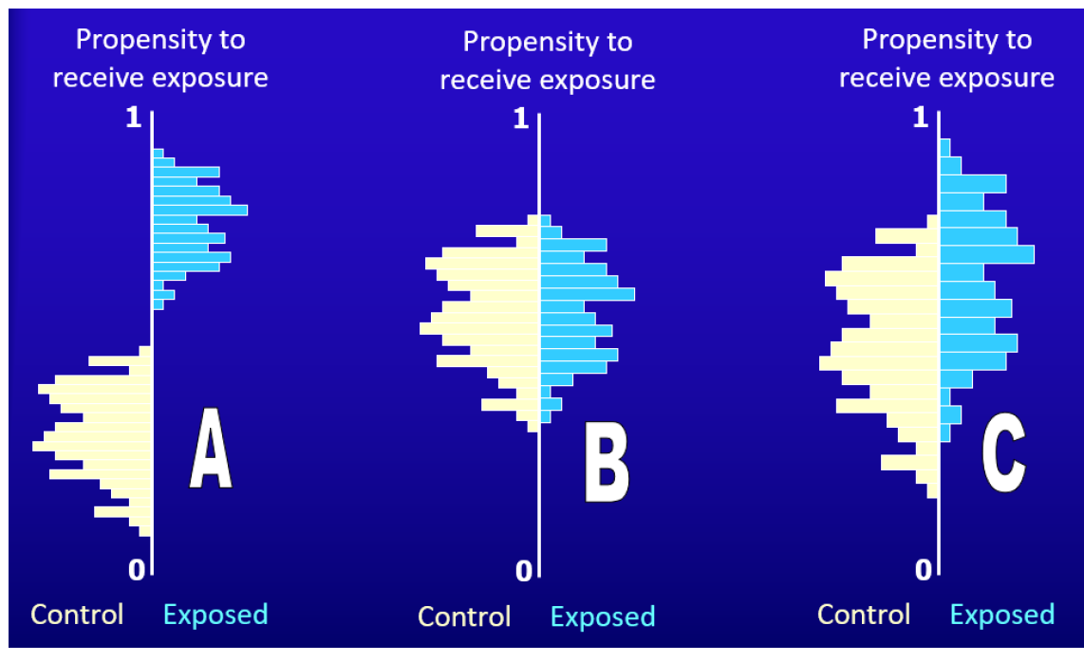
Diagnostics: plot weights
Notes:
Plot propensity scores
A: no overlap at all in propensity scores so you cannot separate exposure assignment from exposure impact
B: This is RCT/perfect situation with no confounding/selection bias
C: What you should get when you model your propensity score weights

Slide 47


Diagnostics: standardized differences
In observational study, expect covariates to differ between exposed and unexposed
e.g., those taking prenatal vitamin will be multiparous, have higher education, initiate prenatal care earlier in pregnancy
Quantify covariate imbalance
Assess differences in group distributions by covariates
How different are characteristics by gestational weight gain status?
Bodnar & Hutcheon. 2022, Epidem

Slide 48
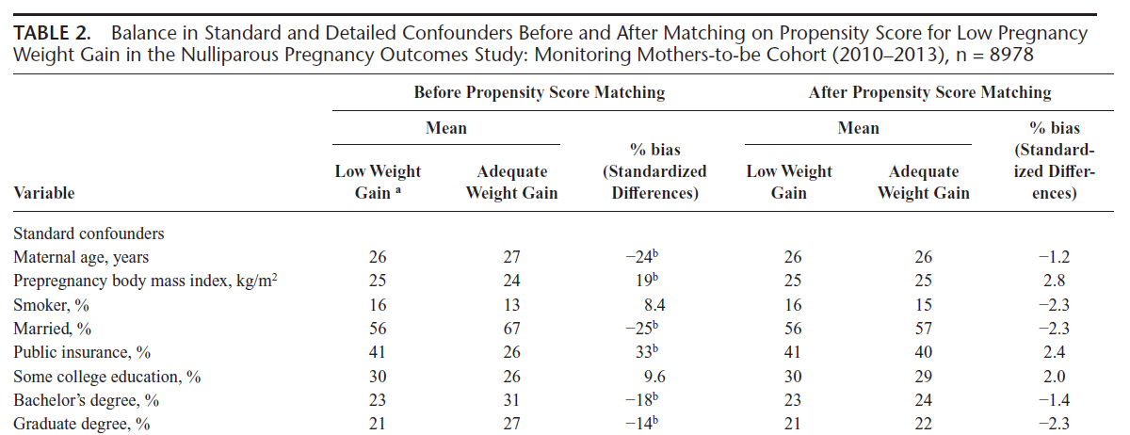
Diagnostics: standardized differences
Goal is to minimize standardize differences (achieve balance in covariates) before moving to next step
Bodnar & Hutcheon. 2022, Epidem
Notes:
Can also plot: Love plot (we’ll see this in our example)
Want stdized differences < 10

Slide 49
Note on trimming weights
In cases where some participants have extreme weights after PS calculation, can “trim” dataset to exclude those participants
Could trim all weights above some criteria (e.g., 95th percentiles)

Slide 50
Propensity scores (IPTW)
2. Fit weighted regression of outcome on exposure using inverse of the conditional probabilities as weights
Apply weights within a second model that estimates effect of exposure on outcome
P(Y=1 | W, X)
P(Y=0 | W, X)
Calculate differences
P(Y=1 | W, X) – P(Y=0 | W,X)
Notes:
No outcome involved in step 1. You’re just predicting who was and wasn’t exposed.

Slide 51
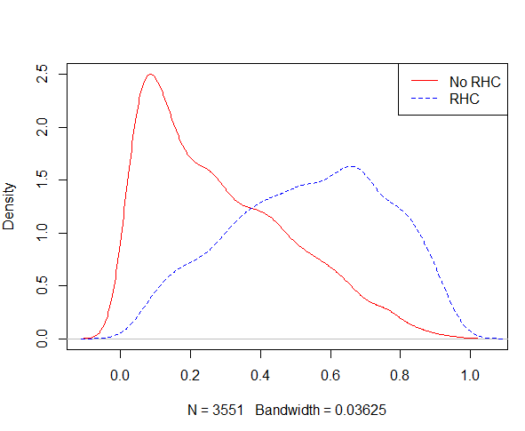
Run in R: PS weights

Slide 52
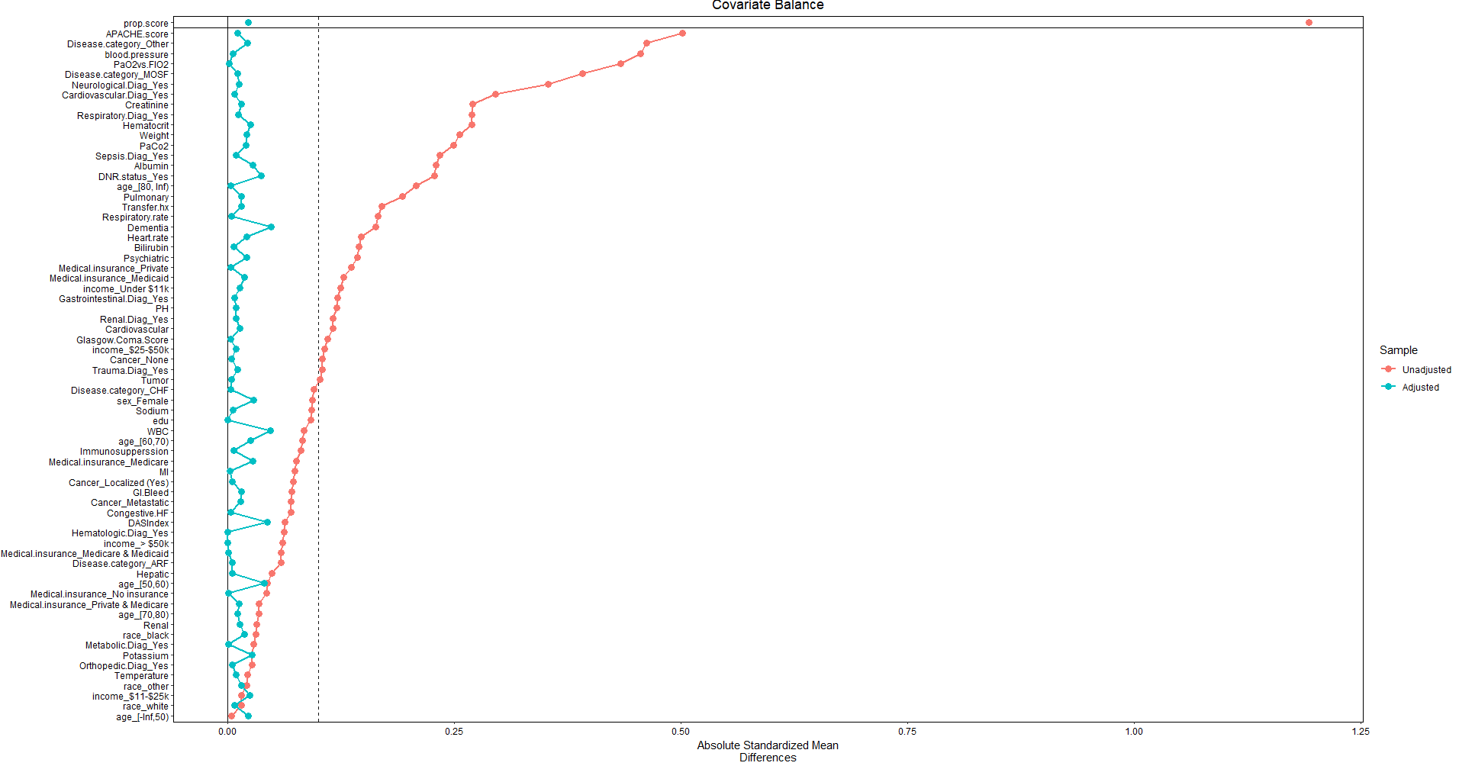
Run in R: Standardized differences

Slide 53
Run in R: Interpret
What was the ATE?
How is this interpreted?
How does the ATE differ from unadjusted estimates?
Notes:
3.24 (1.88, 4.60)
Mean difference in length of stay for those with RHC vs no RHC
Short than unadjusted but

Slide 54
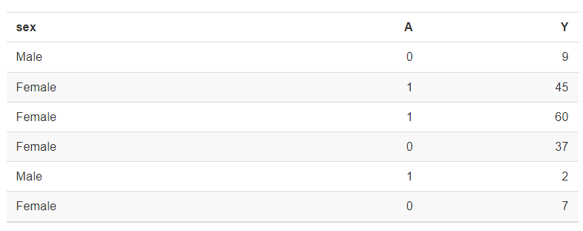
G-computation: Dataset with L=sex
Notes:
Smaller dataset with covariates only including participant sex

Slide 55
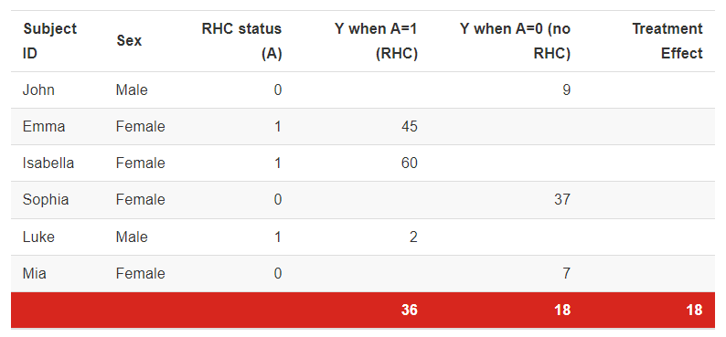
G-computation: Restructure data
Outcomes under different exposure scenarios are in different columns
Think of as a missing data problem

Slide 56
G-computation: Restructure data
Outcomes under different exposure scenarios are in different columns
Predict Ys when A=1 for those where A = 0 in the observed data

Slide 57
G-computation: Restructure data
Outcomes under different exposure scenarios are in different columns
Predict Ys when A=0 for those where A = 1 in the observed data
Notes:
Want to predict what Y is when A = 0

Slide 58
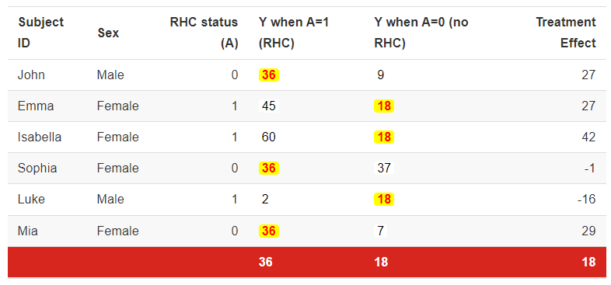
G-computation: Estimate individual differences
- =

Slide 59
G-computation: Average individual differences

Slide 60
G-computation
Switch over to a regression approach, taking into account covariates
Steps:
Fit model of outcome given exposures and confounders
From fitted model, predict outcome under exposure levels corresponding to intervention of interest
Calculate difference of the mean predictions for exposure contrasts of interest

Slide 61
G-computation
Fit model of outcome given exposures and confounders
From fitted model, predict outcome under exposure levels corresponding to intervention of interest
P(Y=1 | A, L)
P(Y=0 | A, L)
Calculate difference of the mean predictions for exposure contrasts of interest
Individual differences
P(Y=1 | A, L) - P(Y=0 | A, L) for each participant
Average over individual differences
Average and then calculate CIs using bootstrapping

Slide 62
Run in R: Interpret
What was the ATE?
How is this interpreted?
How does the ATE differ from unadjusted and adjusted estimates?
Notes:
3.24 (1.88, 4.60)
Mean difference in length of stay for those with RHC vs no RHC

Slide 63
A couple of notes…
We just walked through simple examples
Other treatment contrasts possible
Longitudinal settings possible
Complex exposure scenarios (e.g., mixtures)
There are packages that can do this as well!
Iptw, twang
gfoRmula

Slide 64
A couple of notes…
Non- or semi-parametric methods
Machine learning
Doubly robust: TMLE, LTMLE
Remember to check your assumptions (if possible)
Counterfactual consistency
Not verifiable
Conditional exchangeability
Not verifiable
Positivity
Empirically assess by examining exposure distributions within strata of confounders

Slide 65
Danielle Stevens
Danielle.stevens@nih.gov
https://simplydani99.github.io/

